Slide 1


Strain analysis for the plateau of Iran
XIV
Aliakbar Zarkoob
June 2024
Lecture for the Seminar course

Slide 2
Contents
Foreword
Displacement gradient tensor and deformation gradient tensor.
Strain concepts and strain tensors
Strain tensor from displacement observations
Strain analysis in Action

Slide 3
Foreword
• Deformation of the earth is directly related to geodetic observations.
• Increase in the number and accuracy of geodetic observations, has resulted in various displacement and velocity observations.
• This observations can describe various geodynamic processes.
• The strain tensor of the earth's crust is one of the direct results of geodetic observations.

Slide 4
Displacement Gradient Tensor & Deformation Gradient Tensor
• Displacement vector:

Slide 5
Strain Concepts & Strain Tensors
• Strain: Relative deformation, compared to a reference position configuration.
I. Cauchy-Green strain tensor:
II. Lagrangian finite strain tensor:

Slide 6
Strain Concepts & Strain Tensors
III. Eulerian finite strain tensor:

Slide 7
Strain Concepts & Strain Tensors
IV. Principal strain tensor: strain tensor in principal planes, where the shear strains are zero.

Slide 8
Strain Concepts & Strain Tensors
• Strain invariants:

Slide 9
Strain Concepts & Strain Tensors
• Dilation (2D):
• Pure Shear (2D):
• Simple Shear (2D):

Slide 10
Strain Concepts & Strain Tensors
• Strain ellipse (in case of 2D strain tensor):

Slide 11
Strain Tensor From Displacement Observations
I. Finite element method (2D):

Slide 12
Strain Tensor From Displacement Observations
I. Finite element method (2D):
II. Finite difference method (2D):

Slide 13
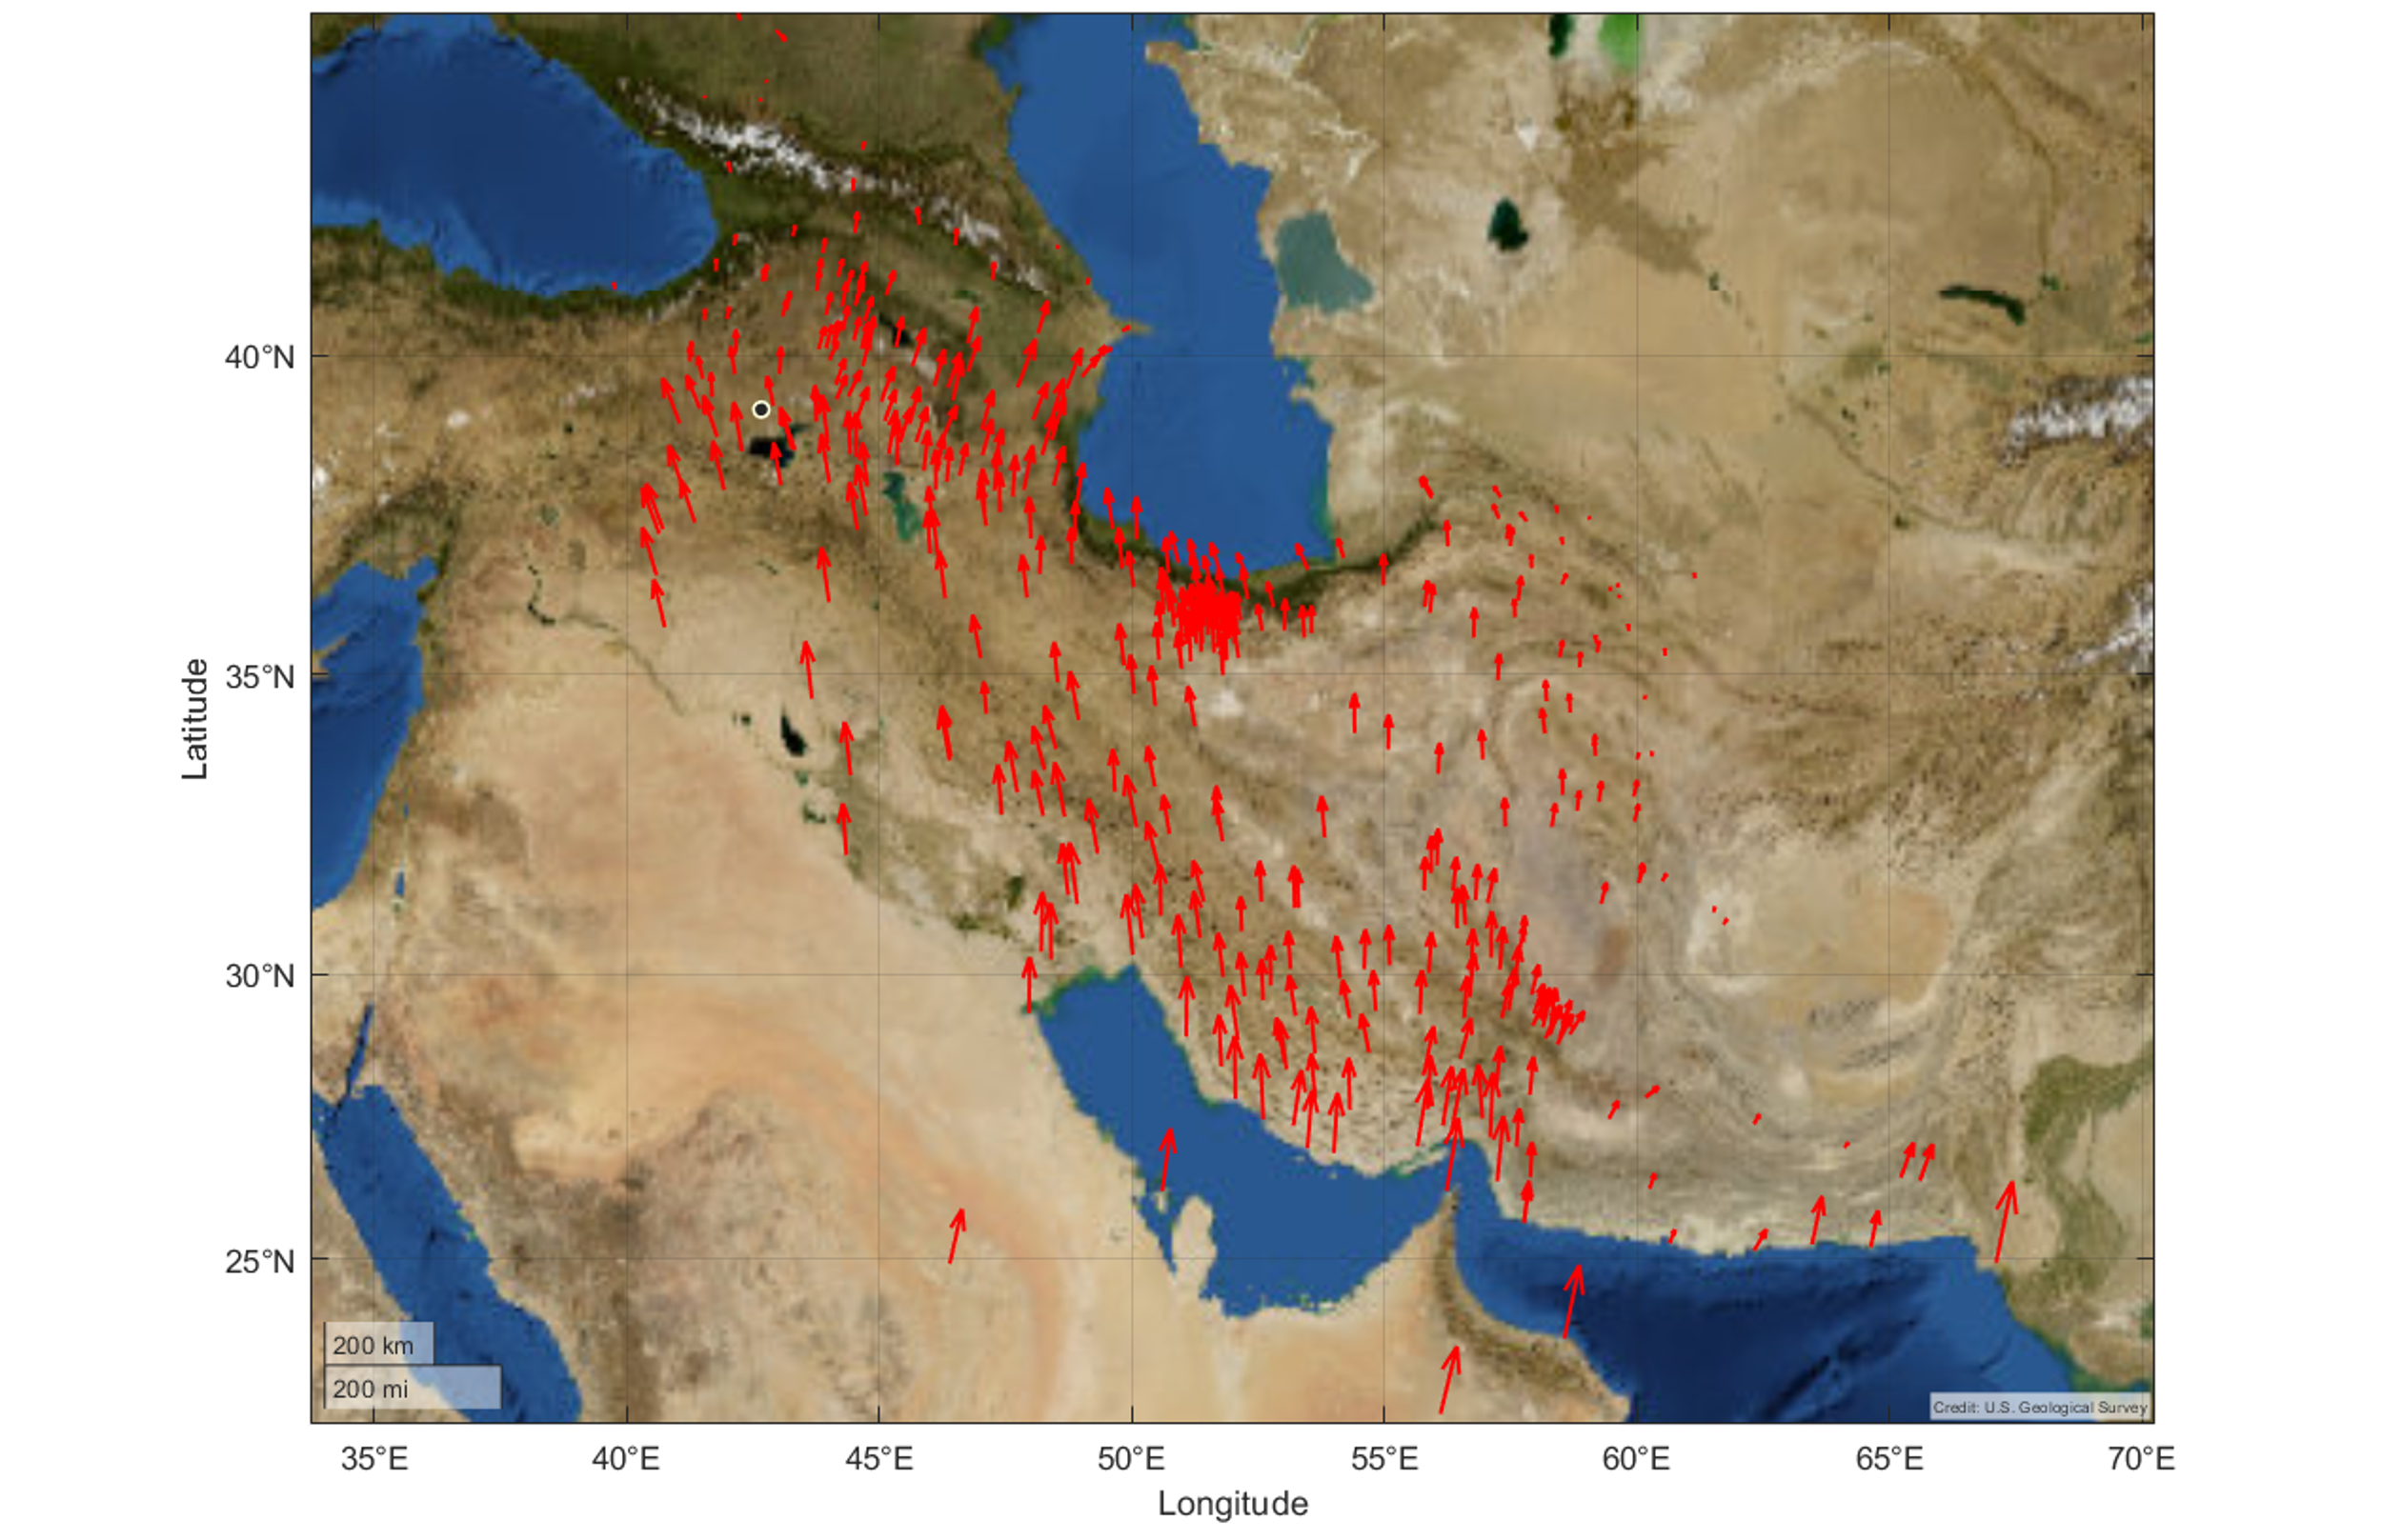
Strain Analysis in Action
GPS velocity field relative to the Eurasian fixed frame

Slide 14
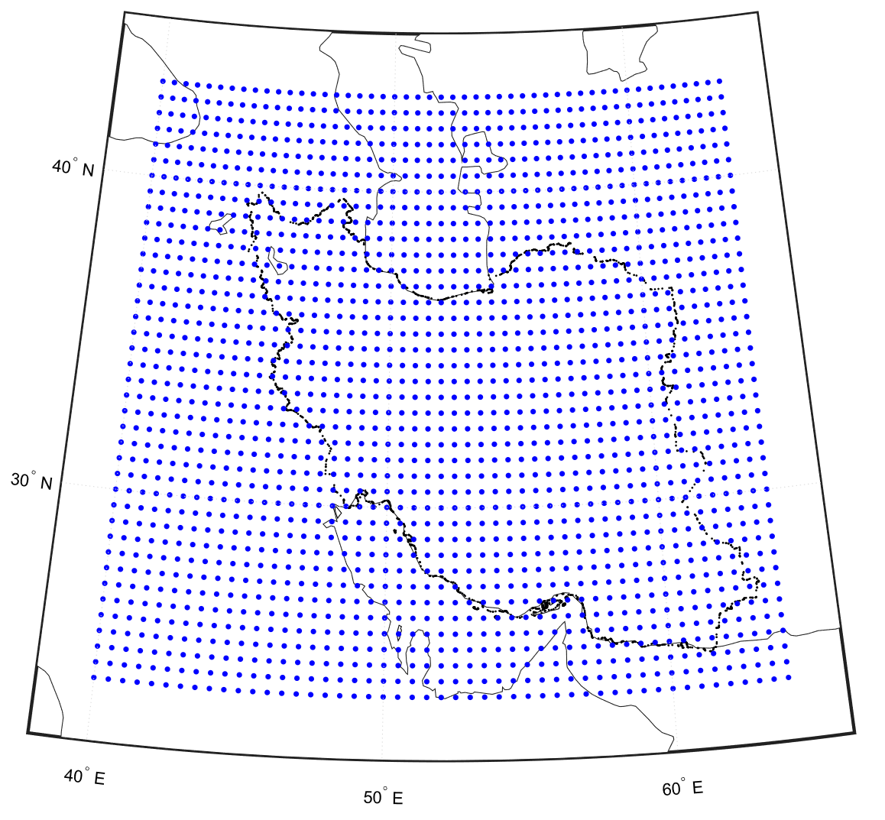
Strain Analysis in Action
Grid Latitude: 24° to 43° Grid Longitude: 40° to 64° Step: 0.25°

Slide 15
Strain Analysis in Action
• Using finite difference method:

Slide 16
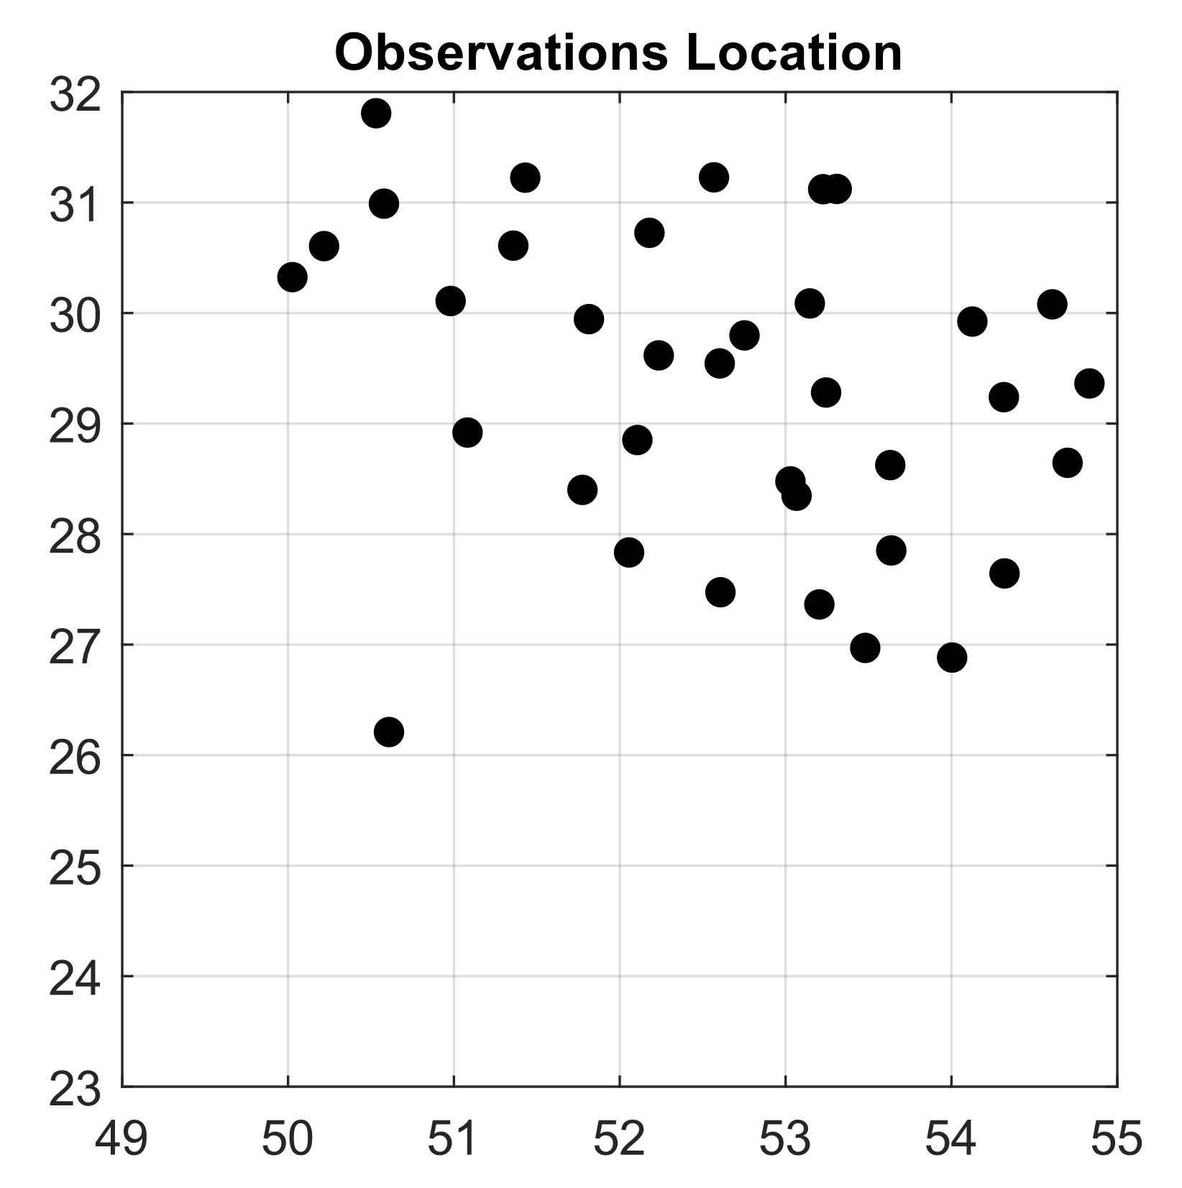
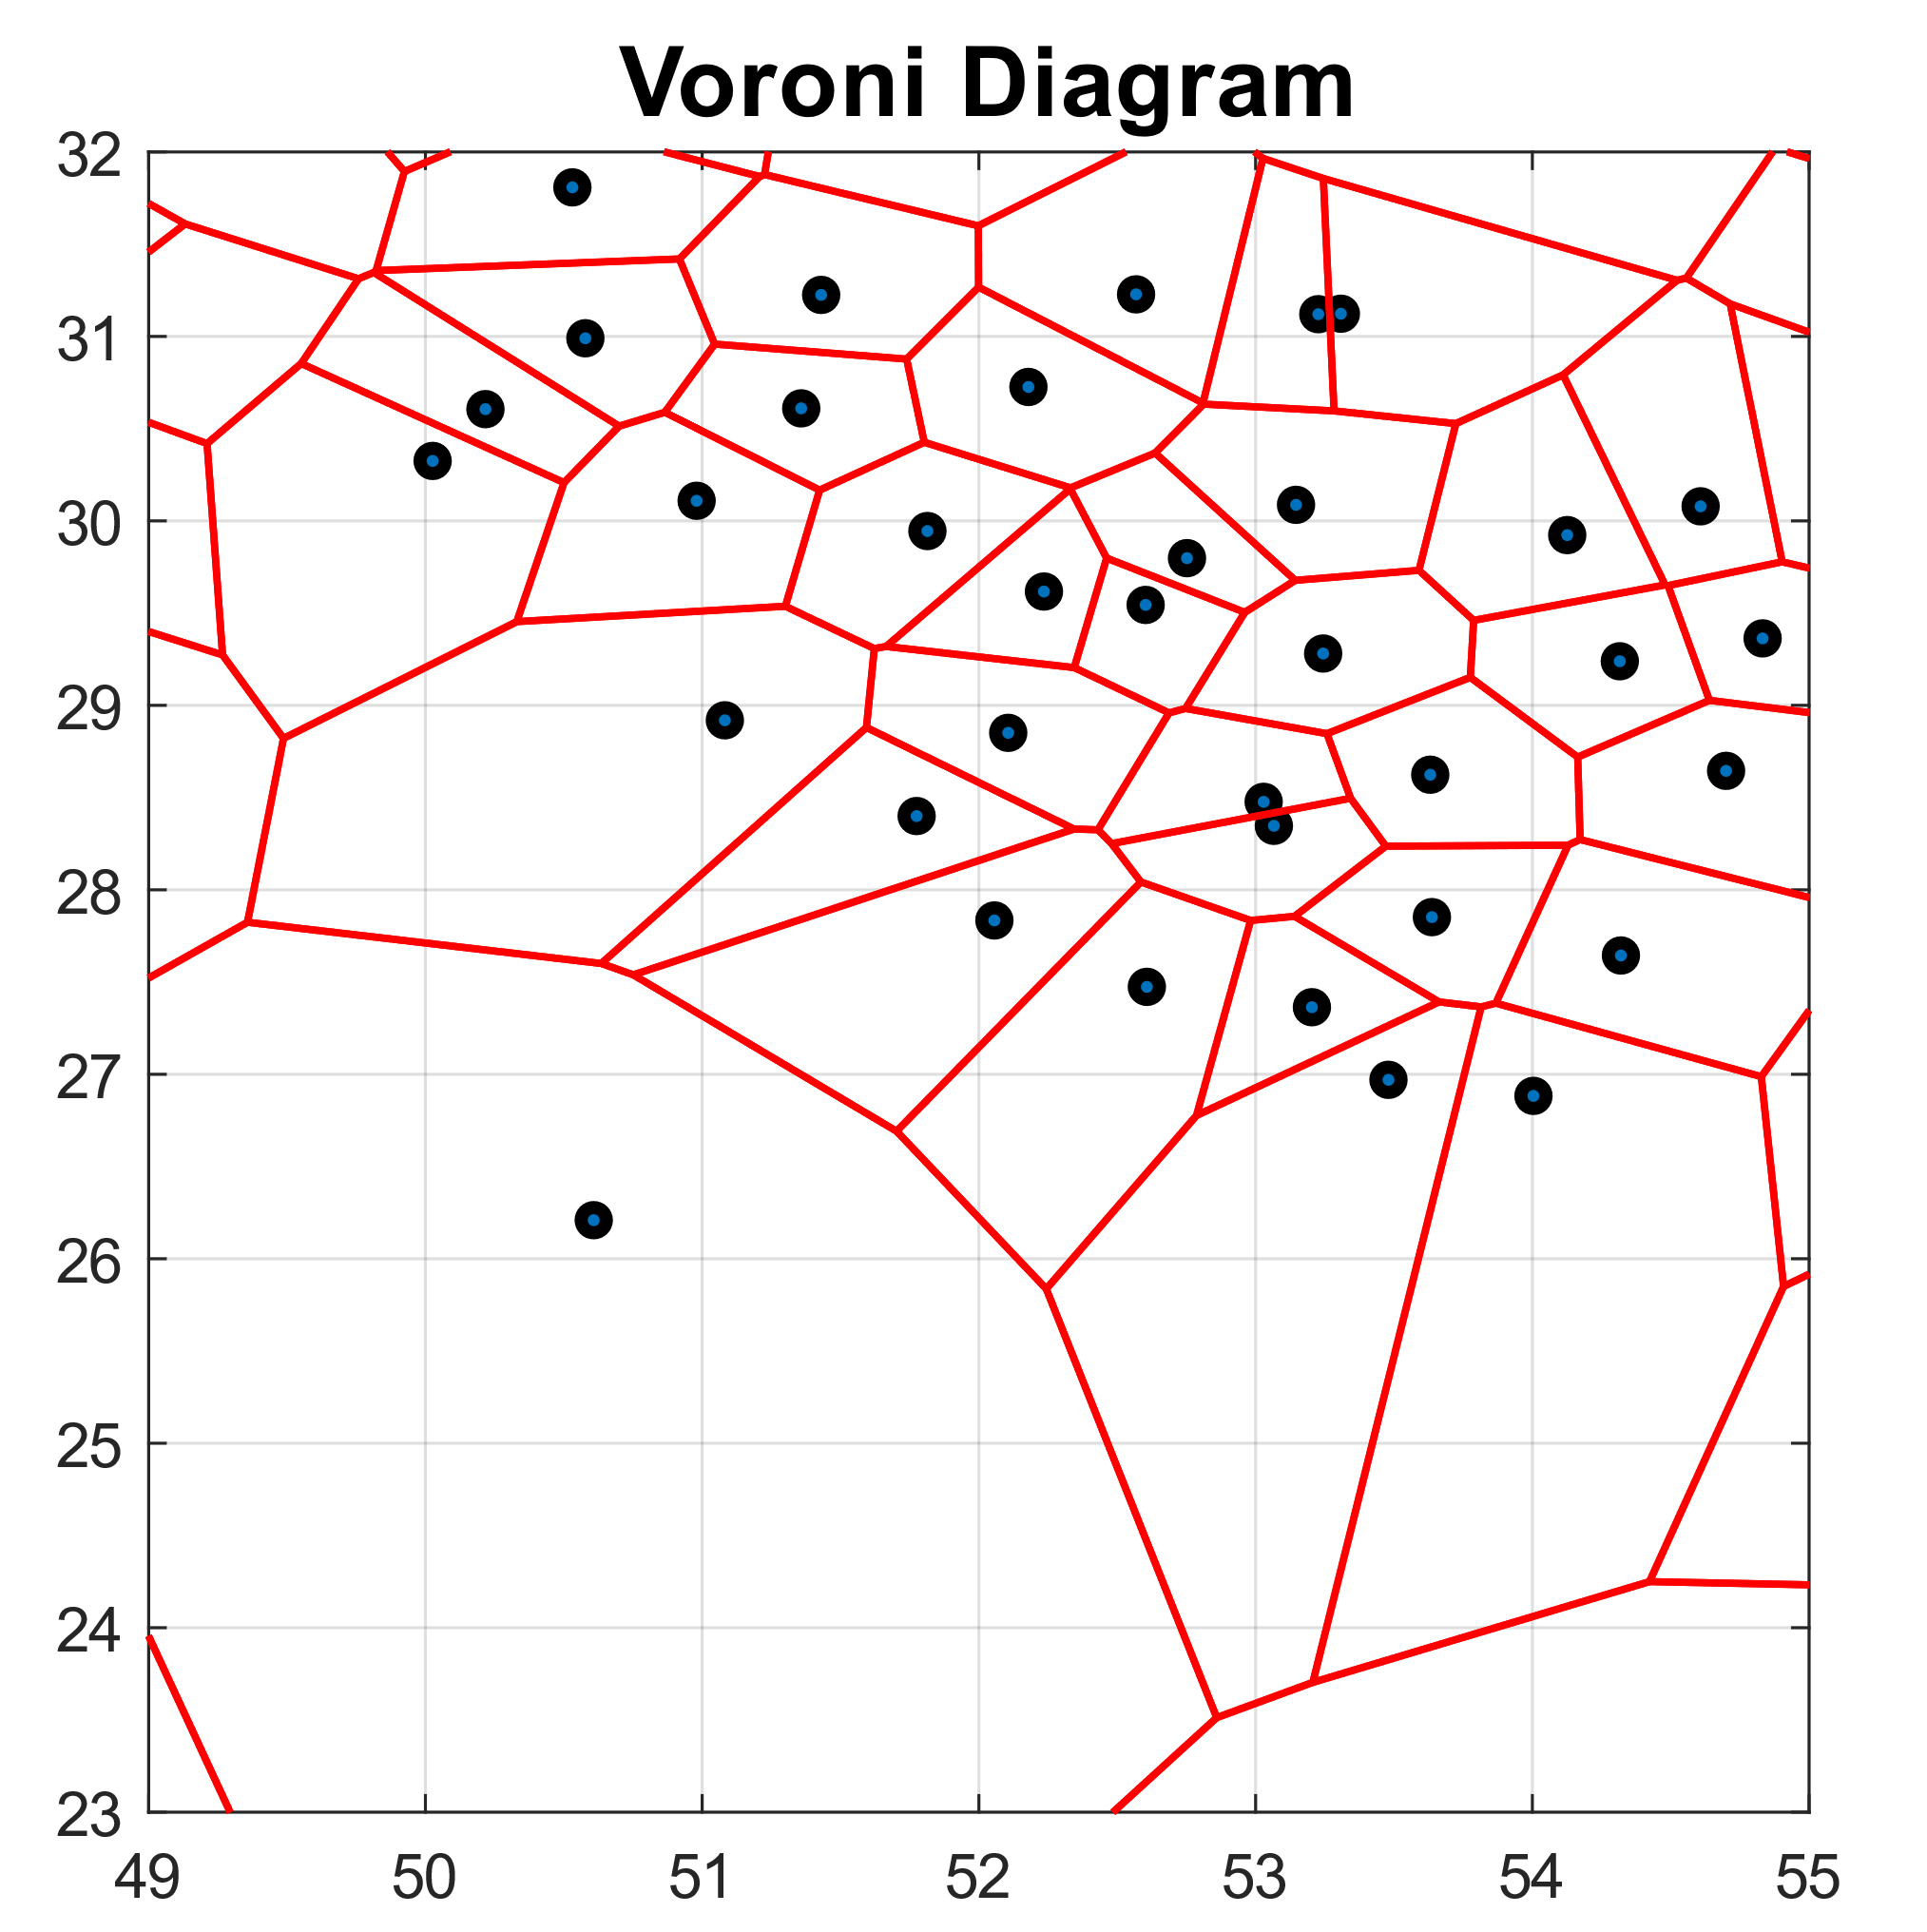
Strain Analysis in Action
• Weight matrix:
I. Based on distance:
II. Based on clustering:

Slide 17
Strain Analysis in Action
• Weight matrix:
III. Based on STD of observations:
• Weighted Least Squares:

Slide 18
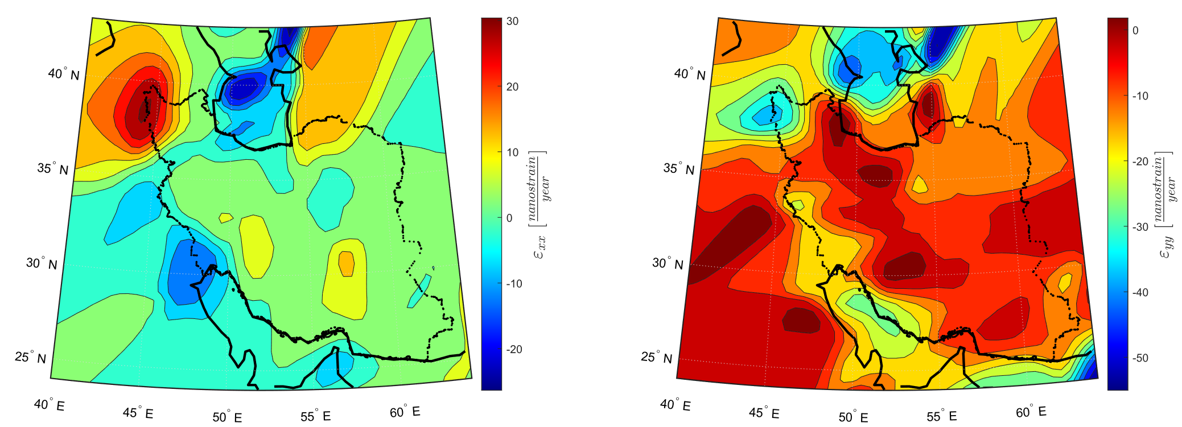
Strain Analysis in Action
Normal strain maps

Slide 19
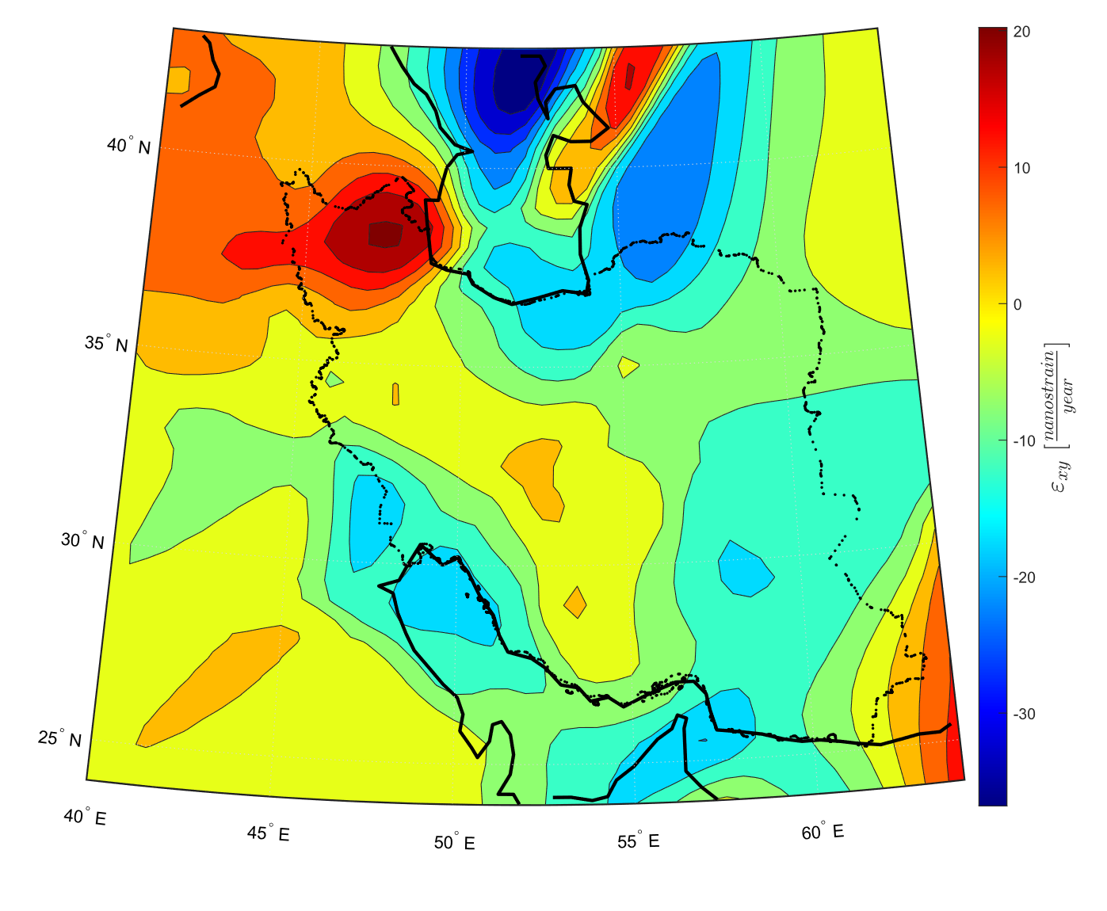
Strain Analysis in Action
Shear strain map

Slide 20
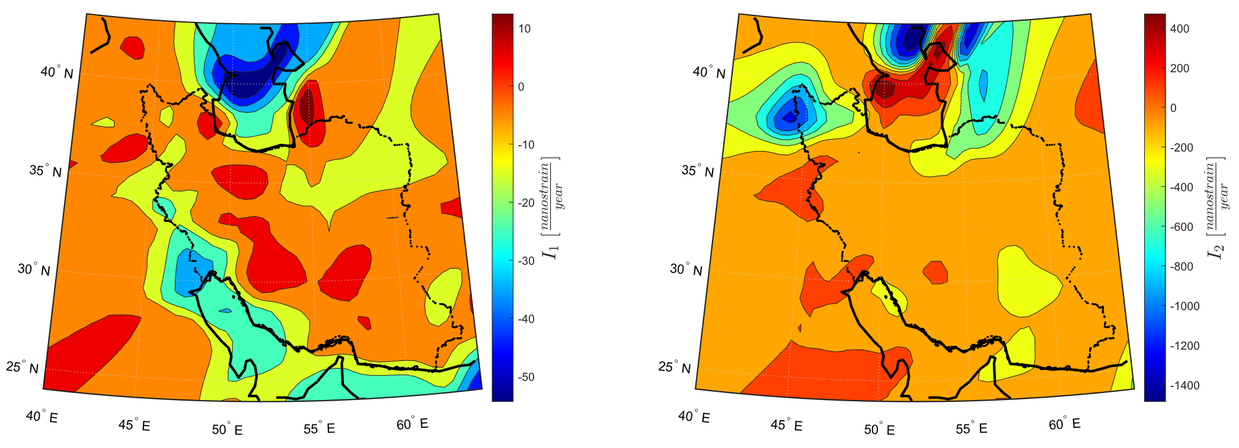
Strain Analysis in Action
Strain invariant maps

Slide 21
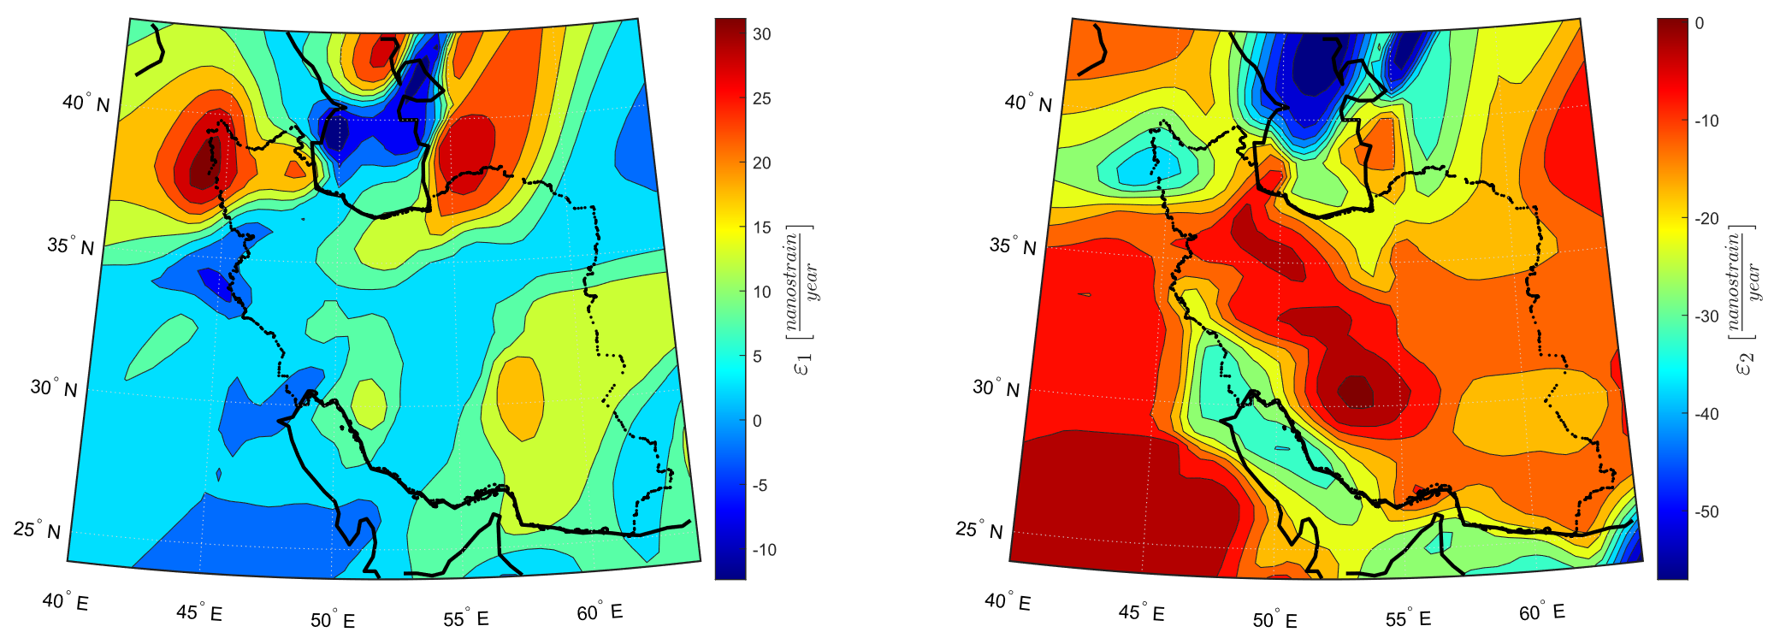
Strain Analysis in Action
Principal strain maps

Slide 22
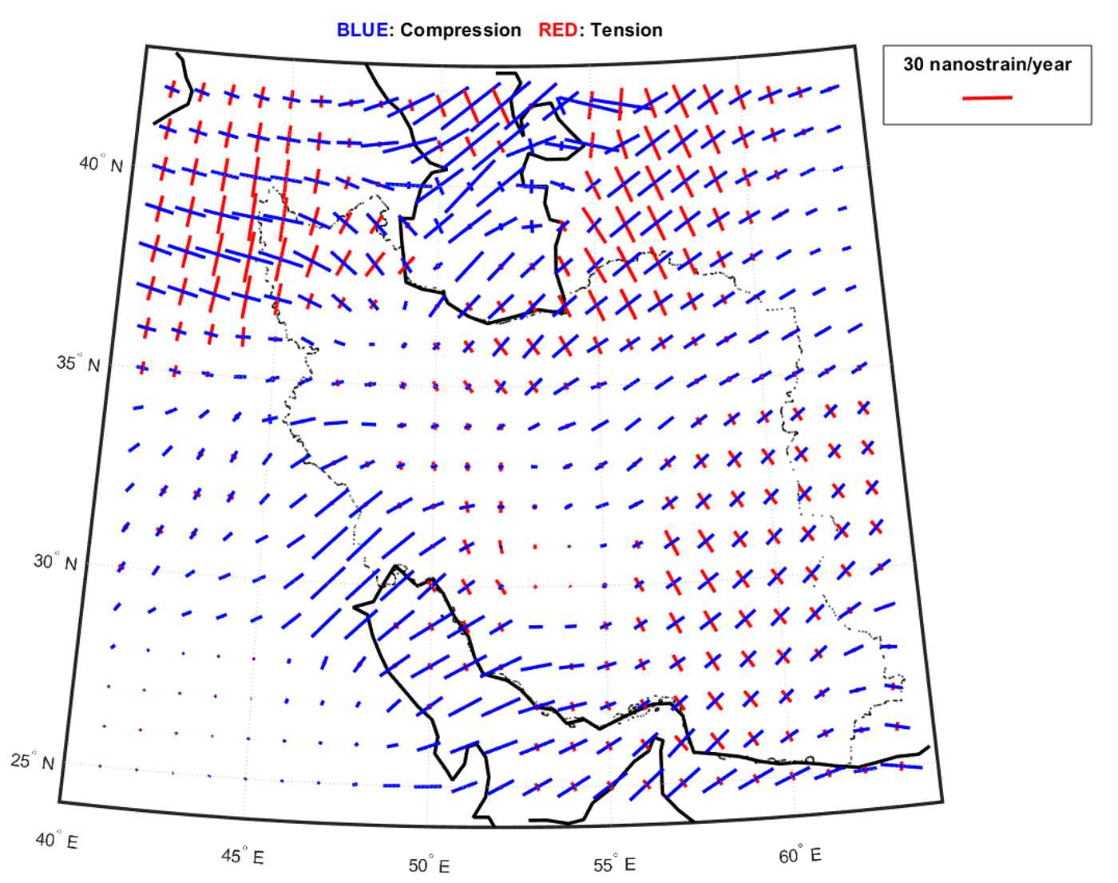
Strain Analysis in Action
Strain ellipse map

Slide 23
References
• Donald L. Turcotte and Gerald Schubert, 1982: Geodynamics third edition.
• Kurt Stiiwe, 2007: Geodynamics Of The Lithosphere second edition.
• Fatemeh Khorrami et al. 2019: An up-to-date crustal deformation map of Iran using integrated campaign-mode and permanent GPS velocities.

